Slide 1
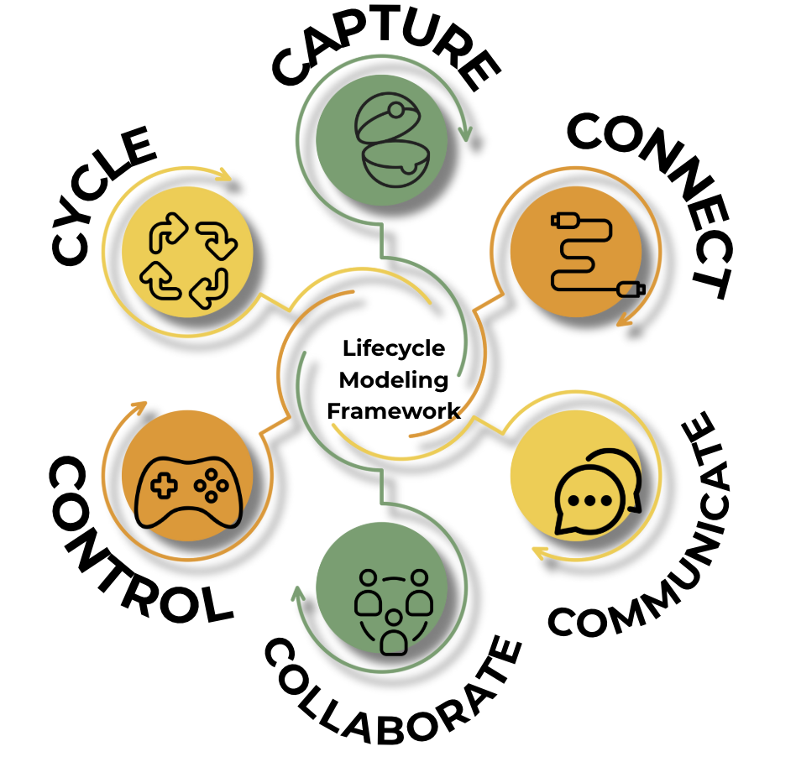
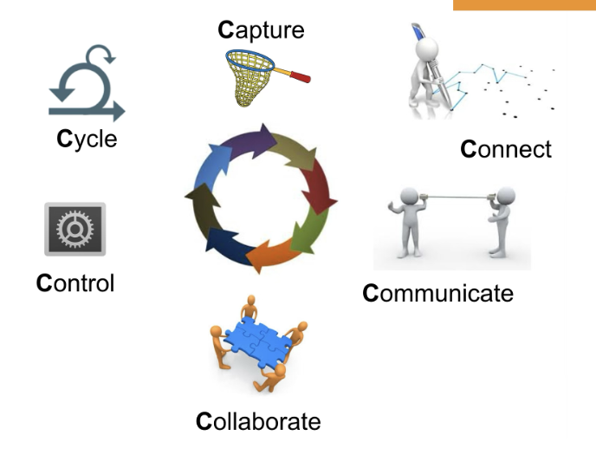
Notes:
6 Cs of LMF

Slide 2
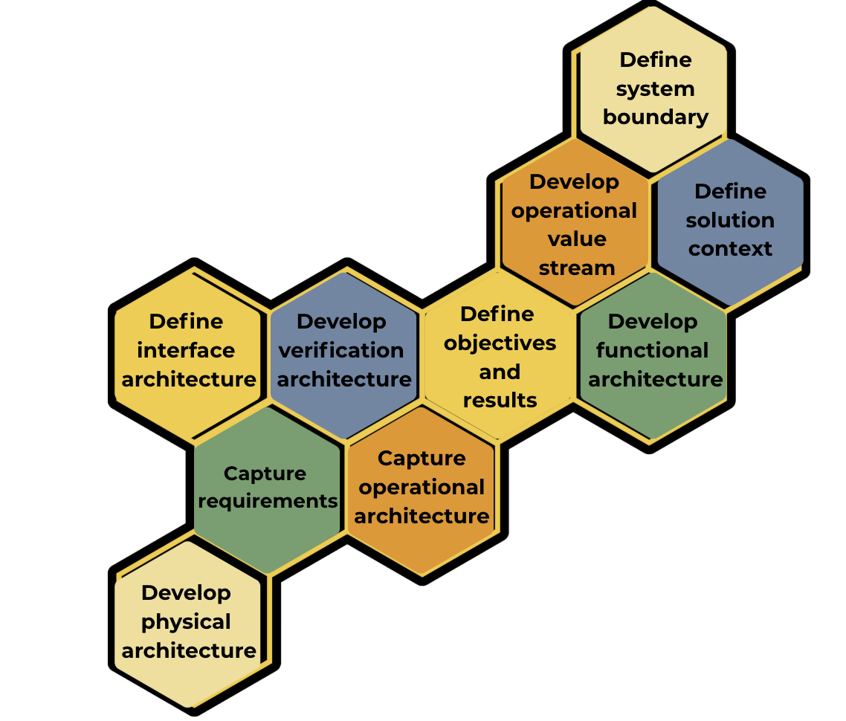
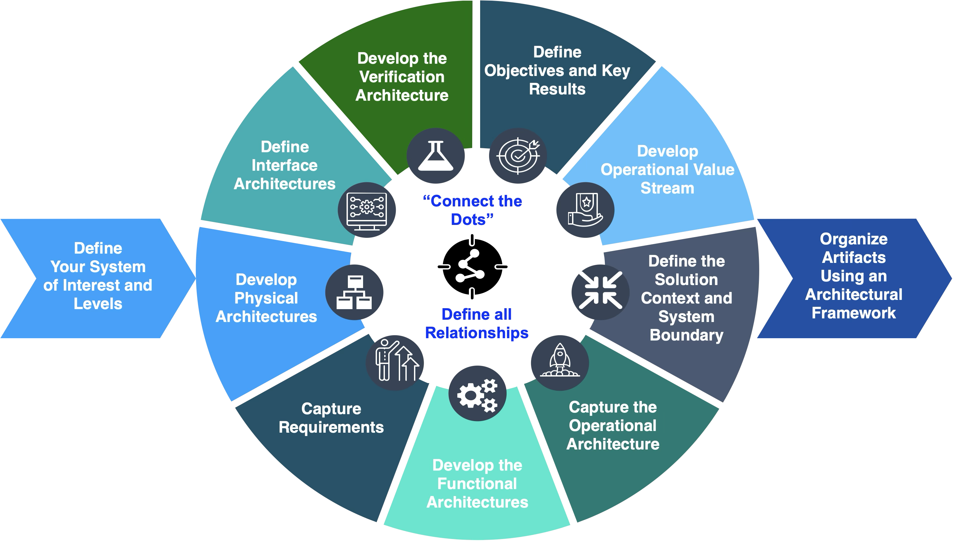
Notes:
Systems modeling tasks

Slide 3
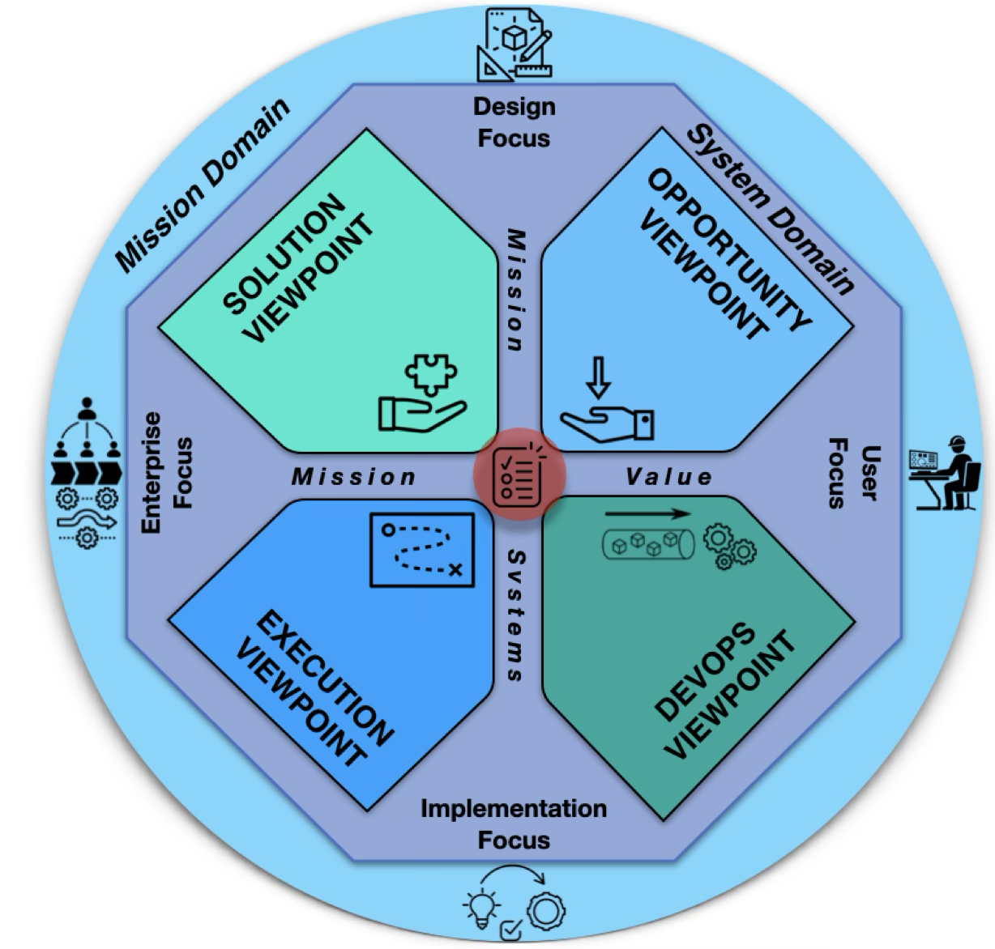
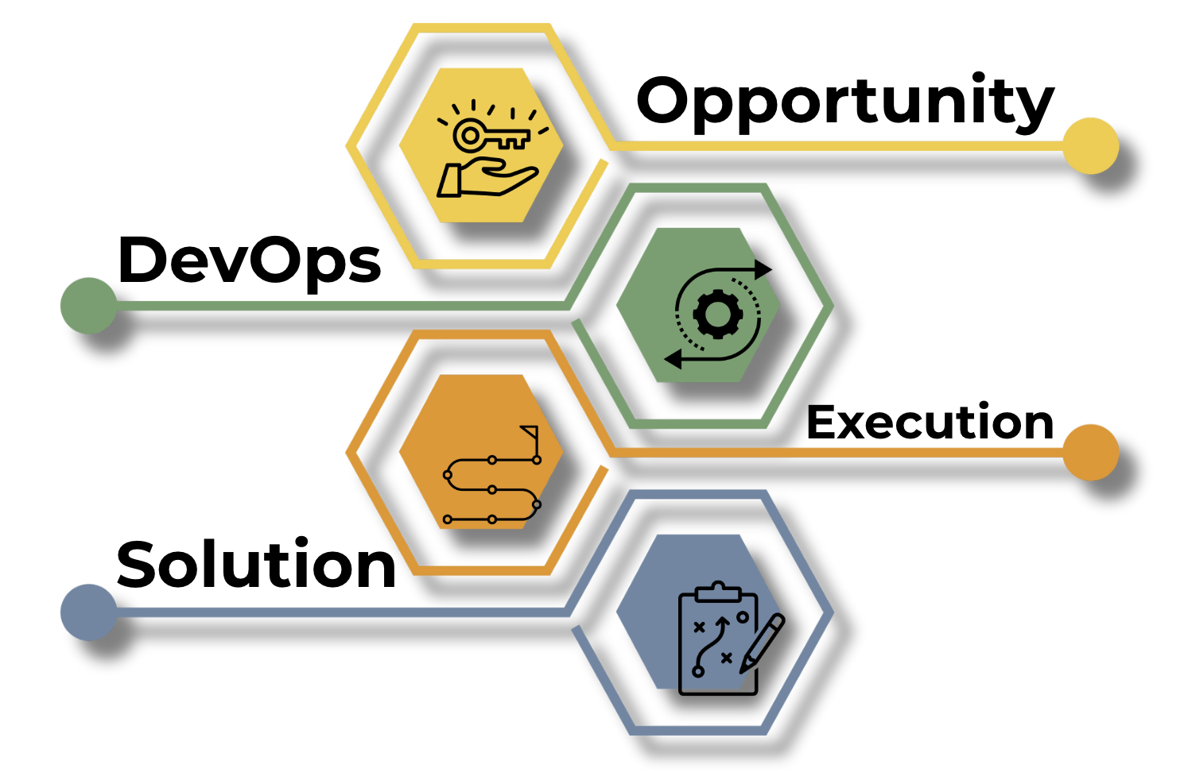
Notes:
LMF viewpoints

Slide 4
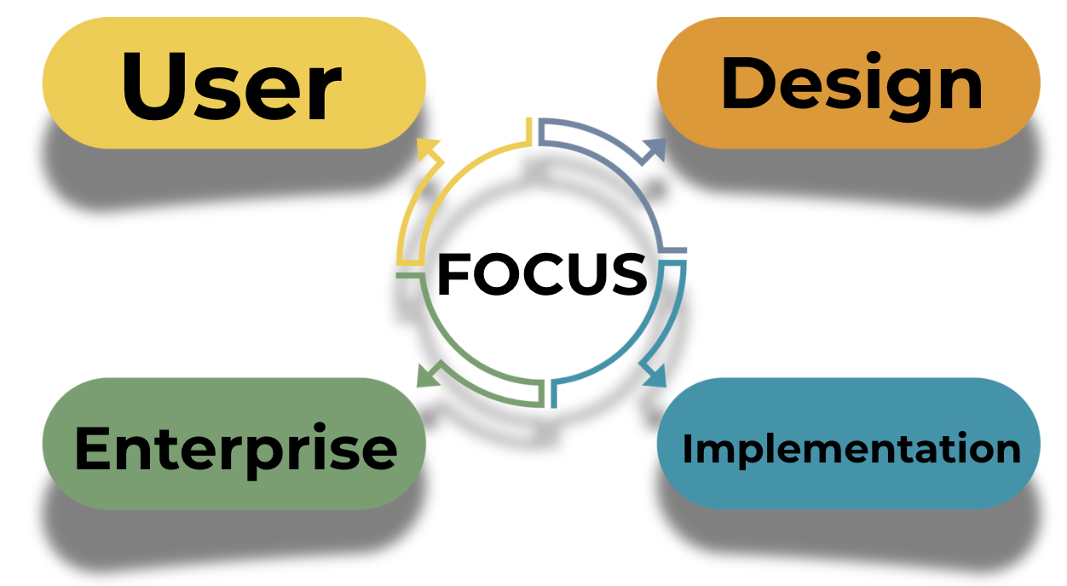
Notes:
4 focus areas of LMF

Slide 5
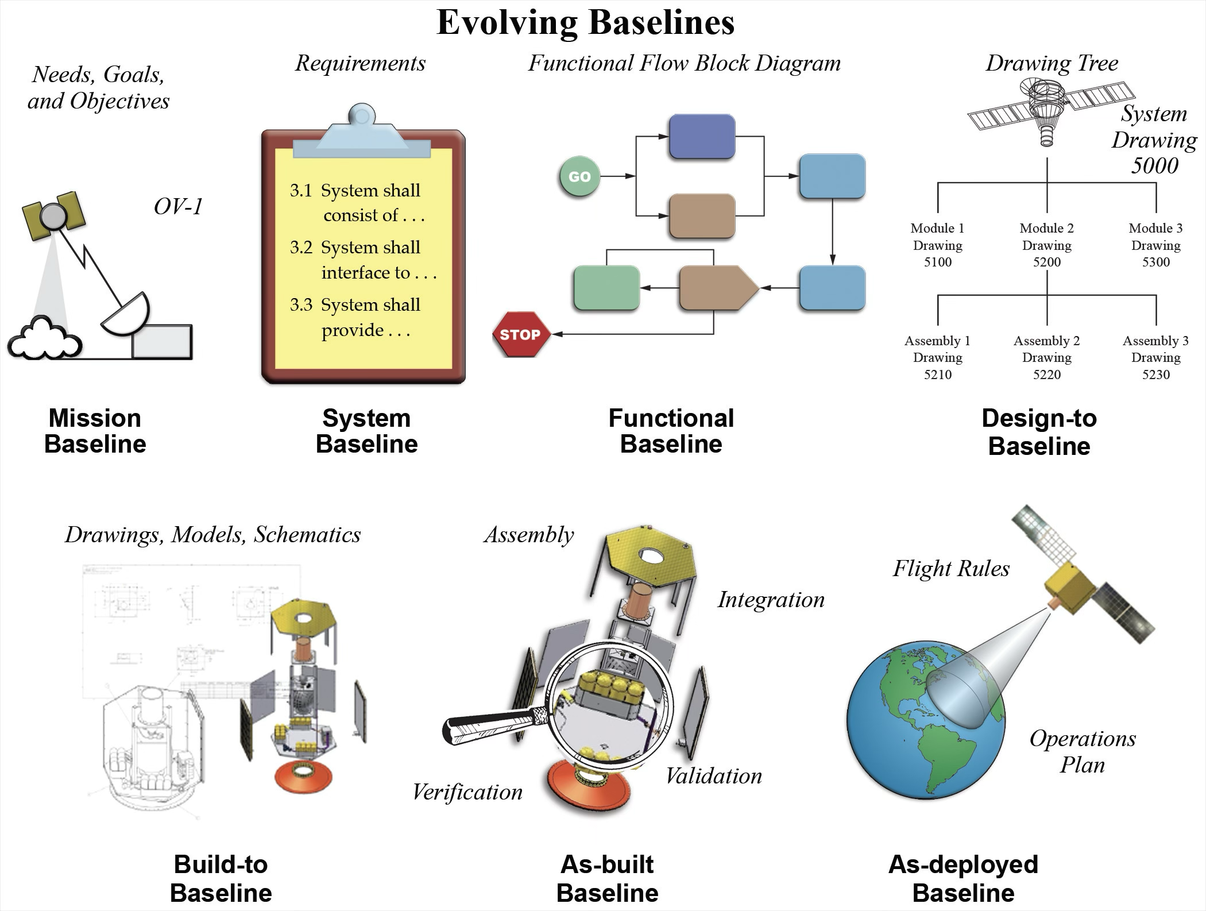
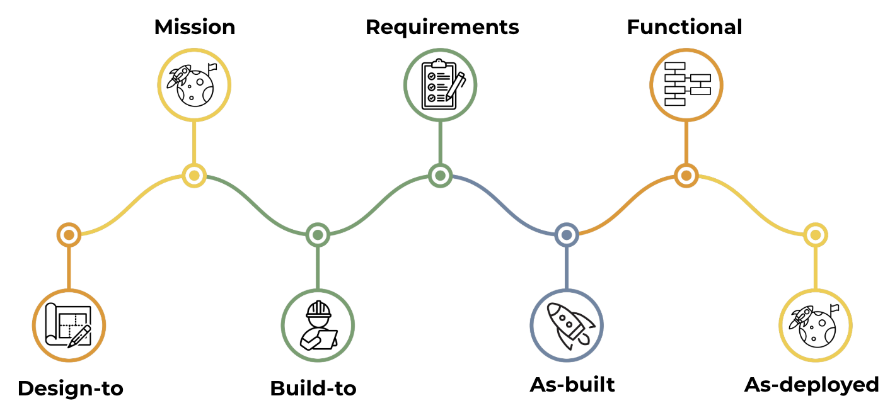
Notes:
baselines

Slide 6



Notes:
Forward and reverse modeling

Slide 7

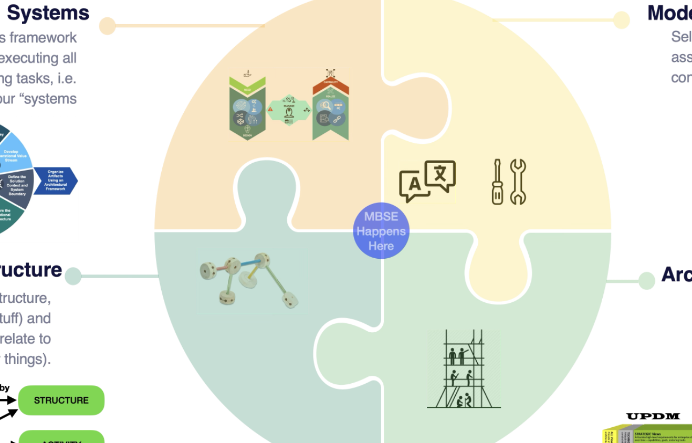
Notes:
Start up necessities

Slide 8
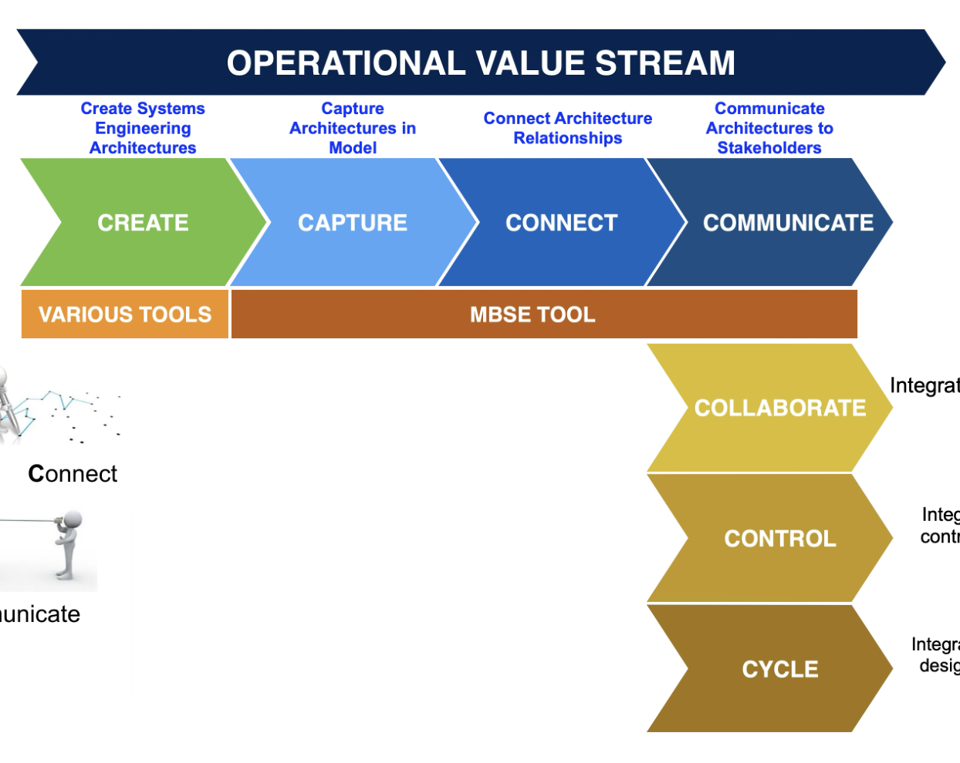
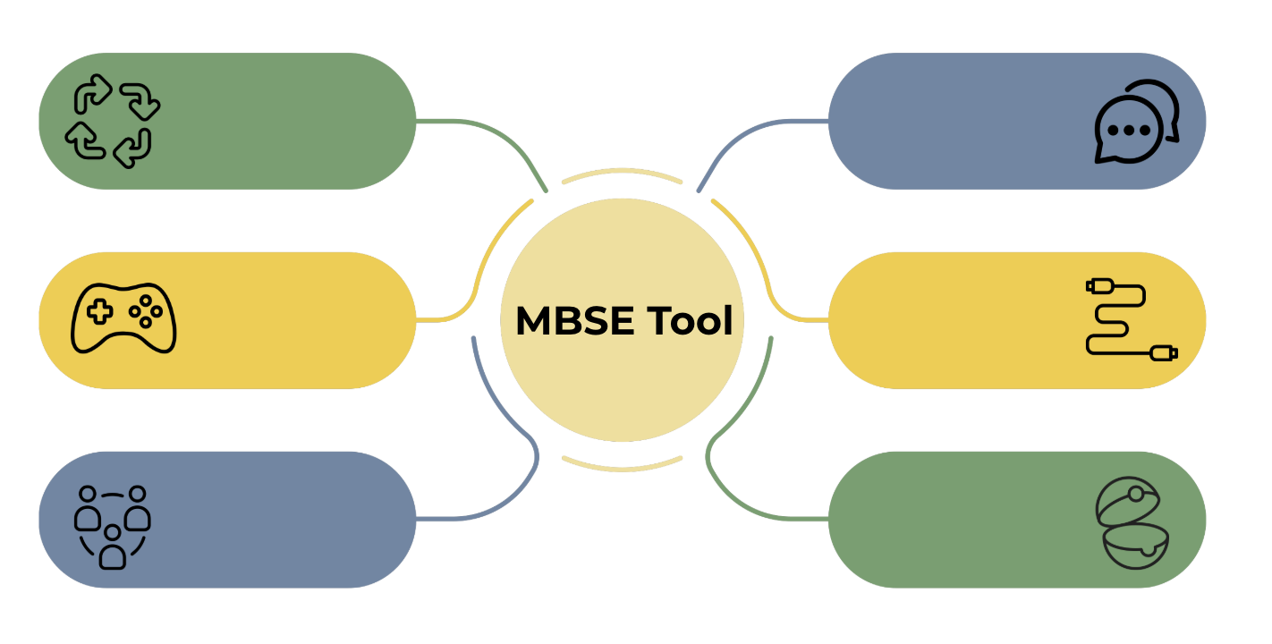
Notes:
MBSE tool

Slide 9
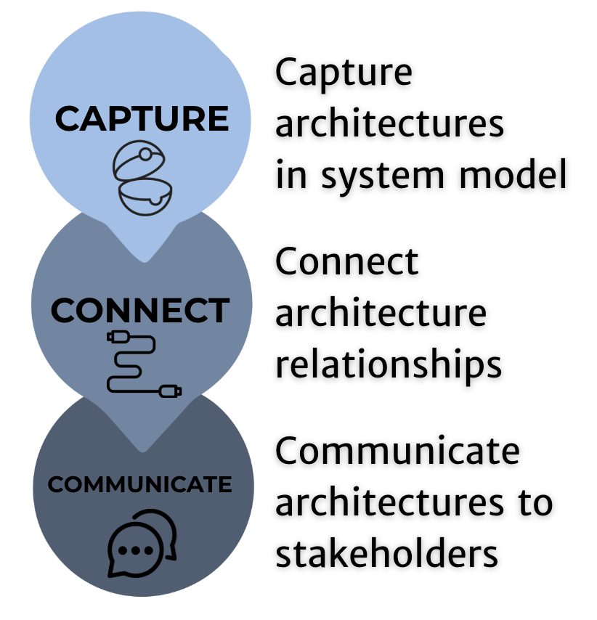

Slide 10
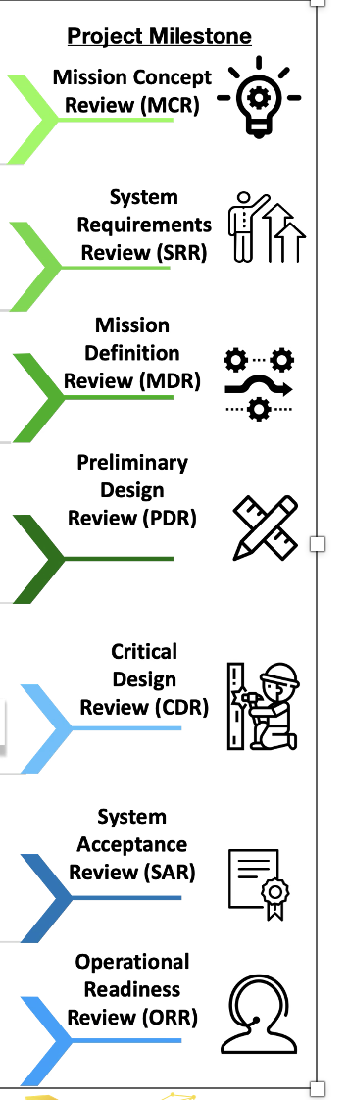
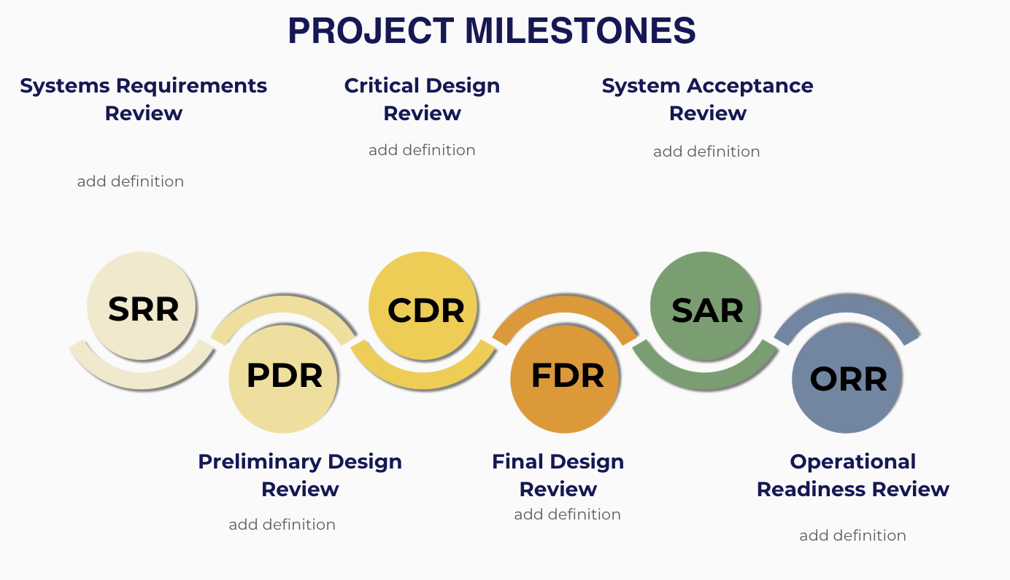

Slide 11
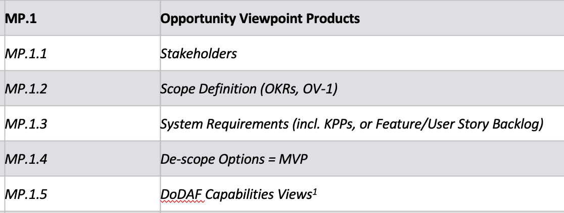
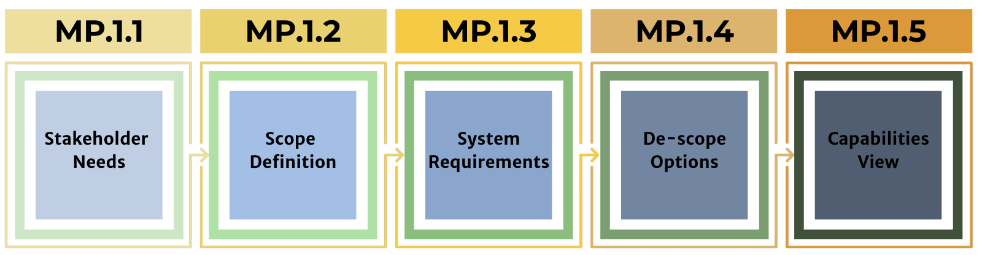
Notes:
Opportunity View Products

Slide 12
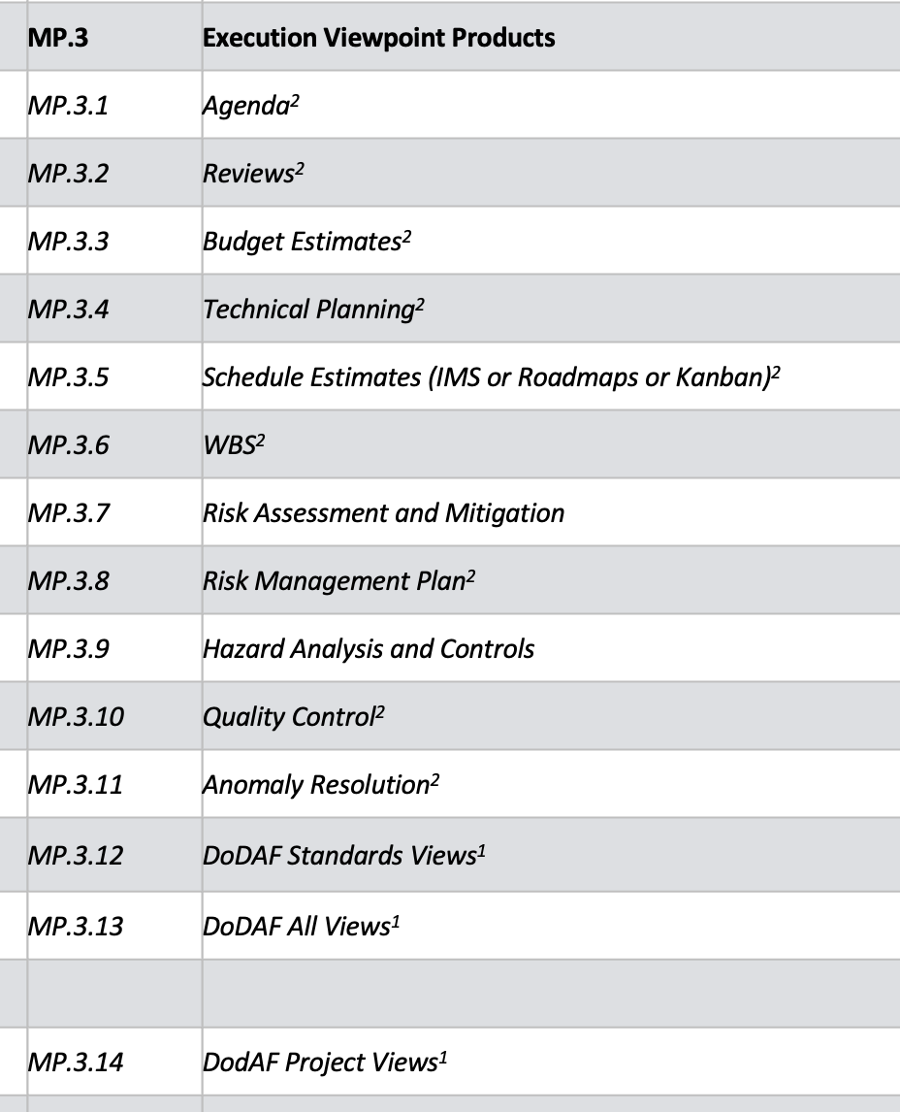
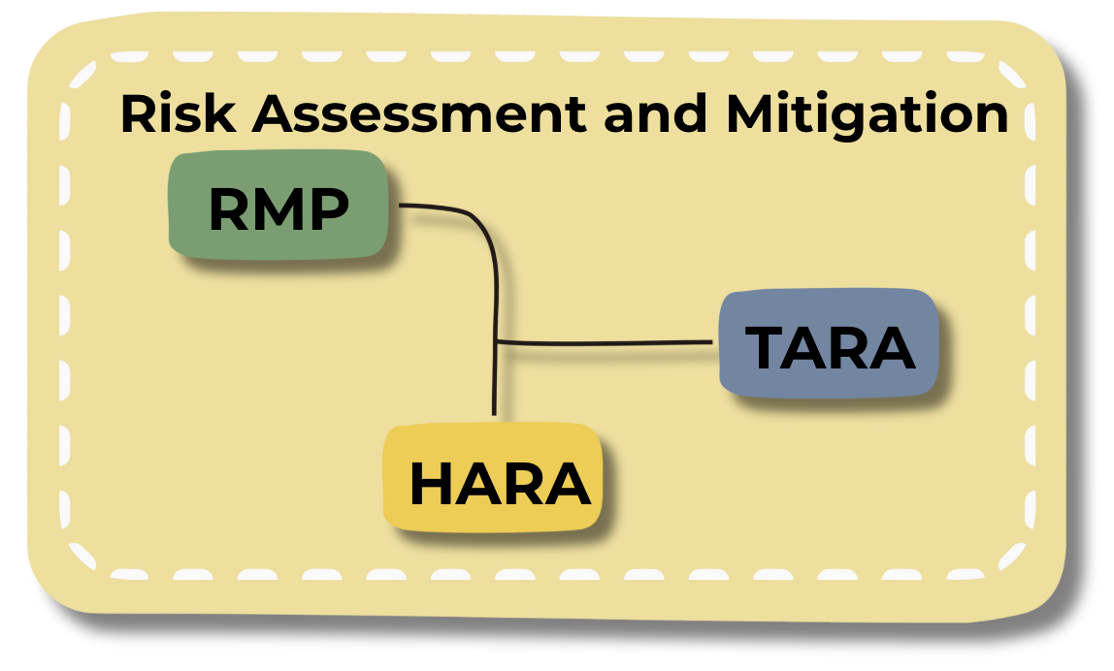
Notes:
Risk deliverables

Slide 13
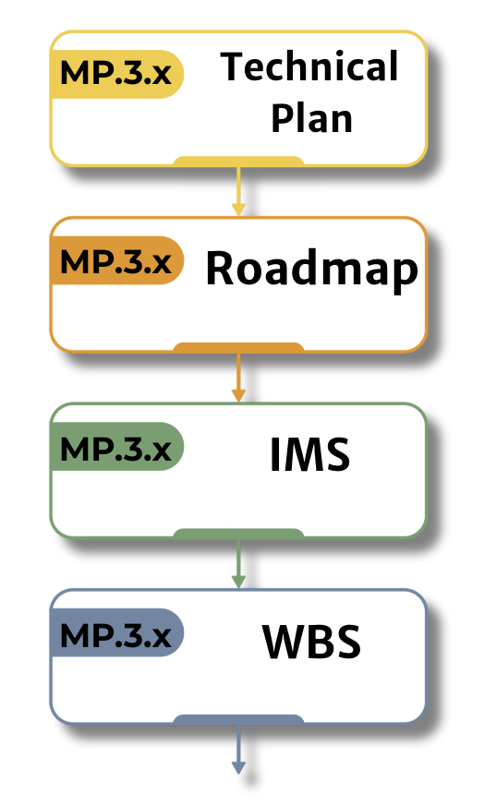
Notes:
scheduling

Slide 14
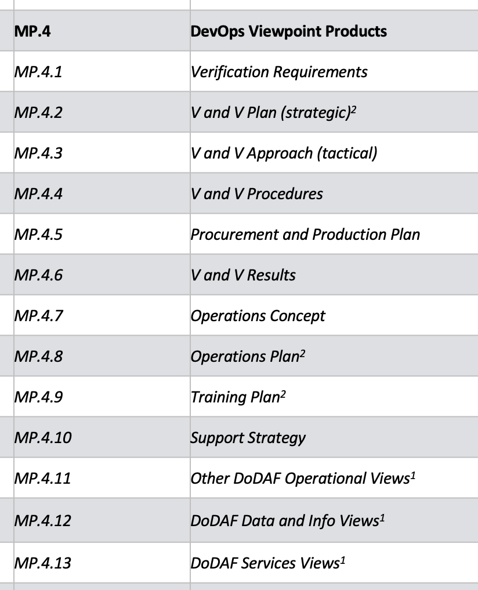
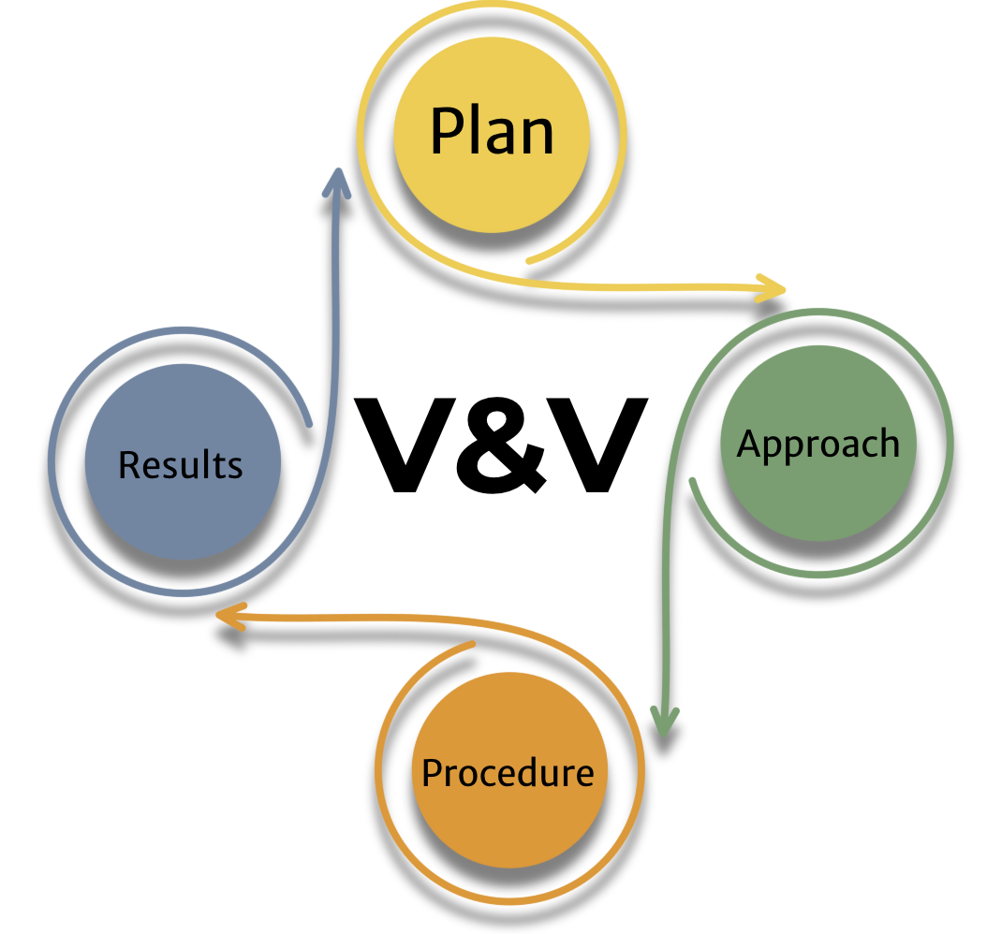
Notes:
V&V

Slide 15
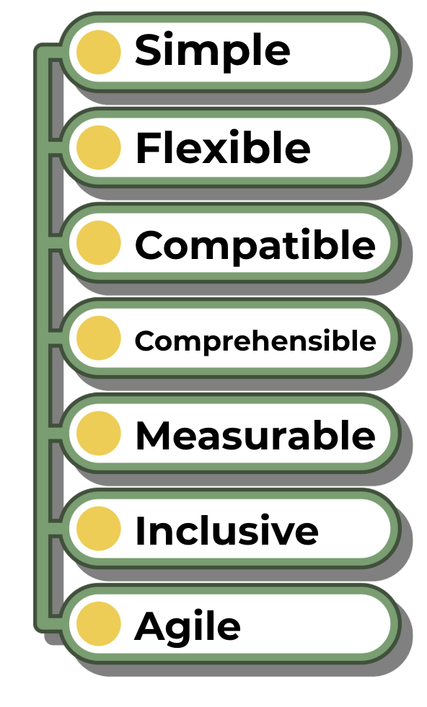
Notes:
LML goals

Slide 16
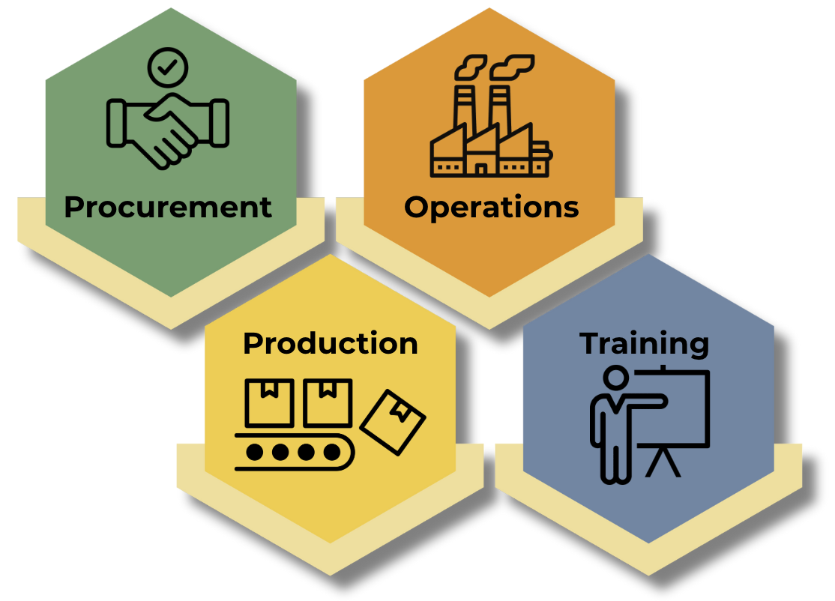
Notes:
plans

Slide 17
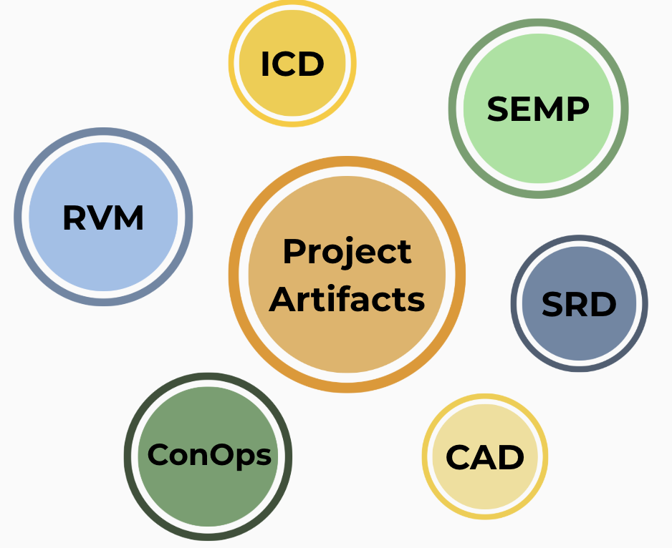
Notes:
Example of artifacts

Slide 18
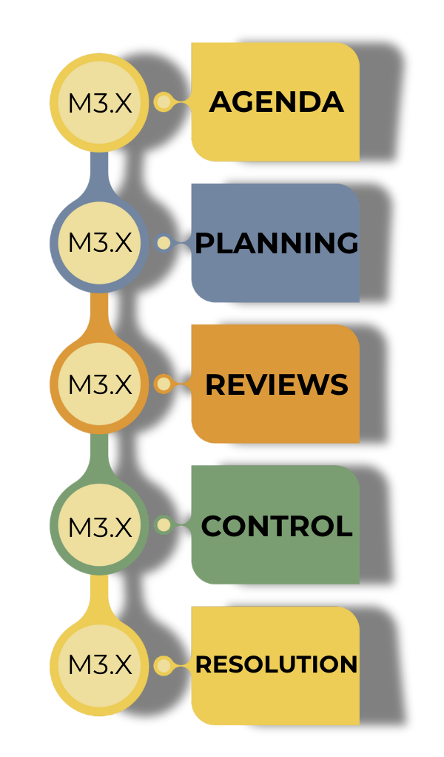
Notes:
QUALITY

Slide 19
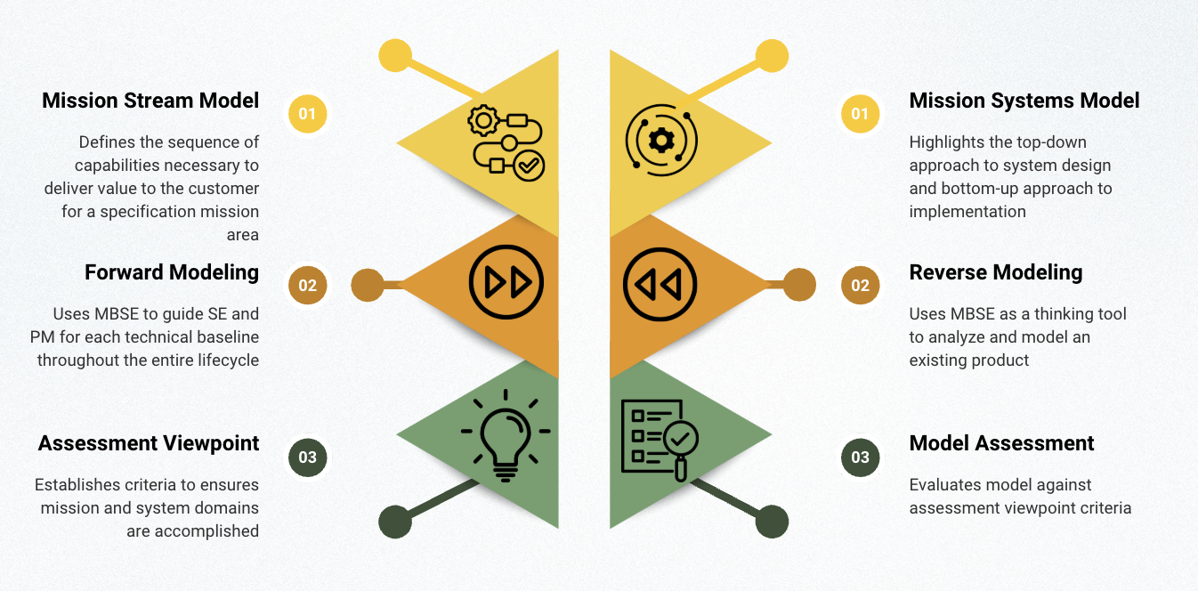
Notes:
LMF Modeling Approach

Slide 20
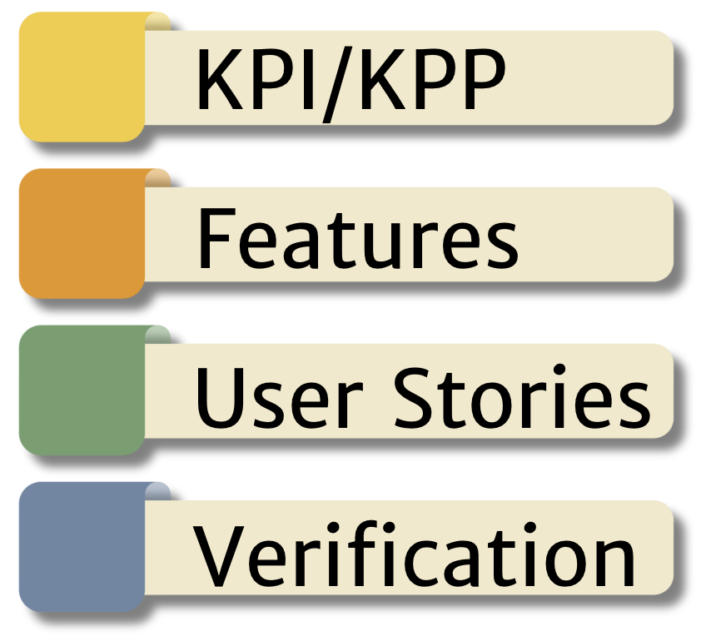
Notes:
Types of requirements

Slide 21
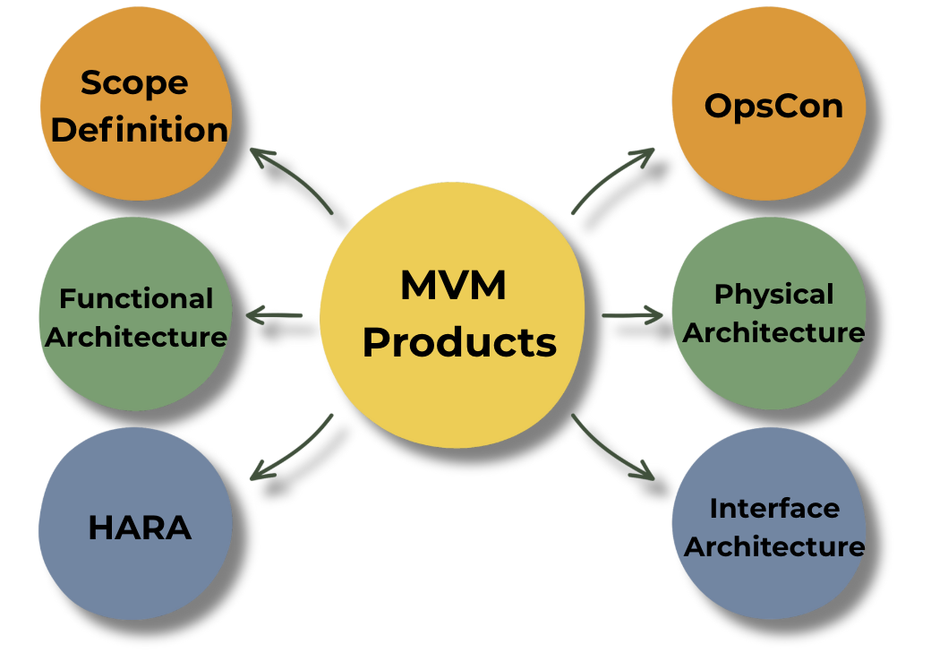
Minimum Viable Model Products
✔︎ | Mission Value Stream Model
✔︎ | Mission Systems Model
✔︎ | MP.1.2 | Scope Definition (OKRs, OV-1)
✔︎ | MP.2.2 | Detailed Functional Architectures
✔︎ | MP.2.3 | Detailed Physical Architectures
✔︎ | MP.2.5 | Interface Architecture (incl. TLM/Cmds)
✔︎ | MP.3.9 | Hazard Analysis and Controls
✔︎ | MP.4.7 | Operations Concept
✔︎ | Assessment Viewpoint Products
Notes:
MVM products

